Slide 1
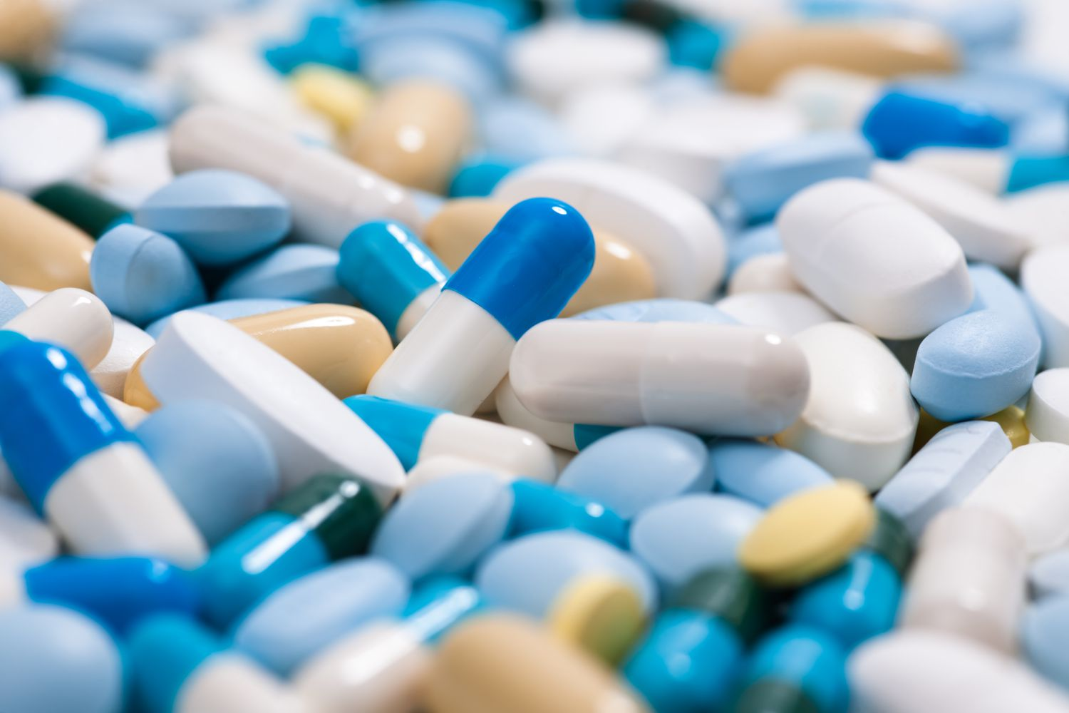
ADVERSE DRUG Reaction ANALYSIS
Present By – Athrva Mule
Library Used – Pandas, Numpy,
Matplotlib, Seaborn

Slide 2
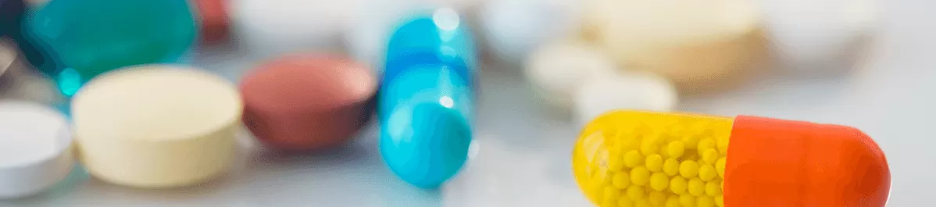
Introduction
In this presentation, we will explore how different drugs react to patients based on various factors. I have analyzed the dataset and identified key patterns and trends. The analysis covers aspects such as patient demographics, dosage effectiveness, side effects, and drug interactions
This research can assist the medical research team in making data-driven decisions, such as identifying the most effective drugs for specific conditions, predicting potential side effects, and optimizing prescriptions for better patient outcomes.

Slide 3
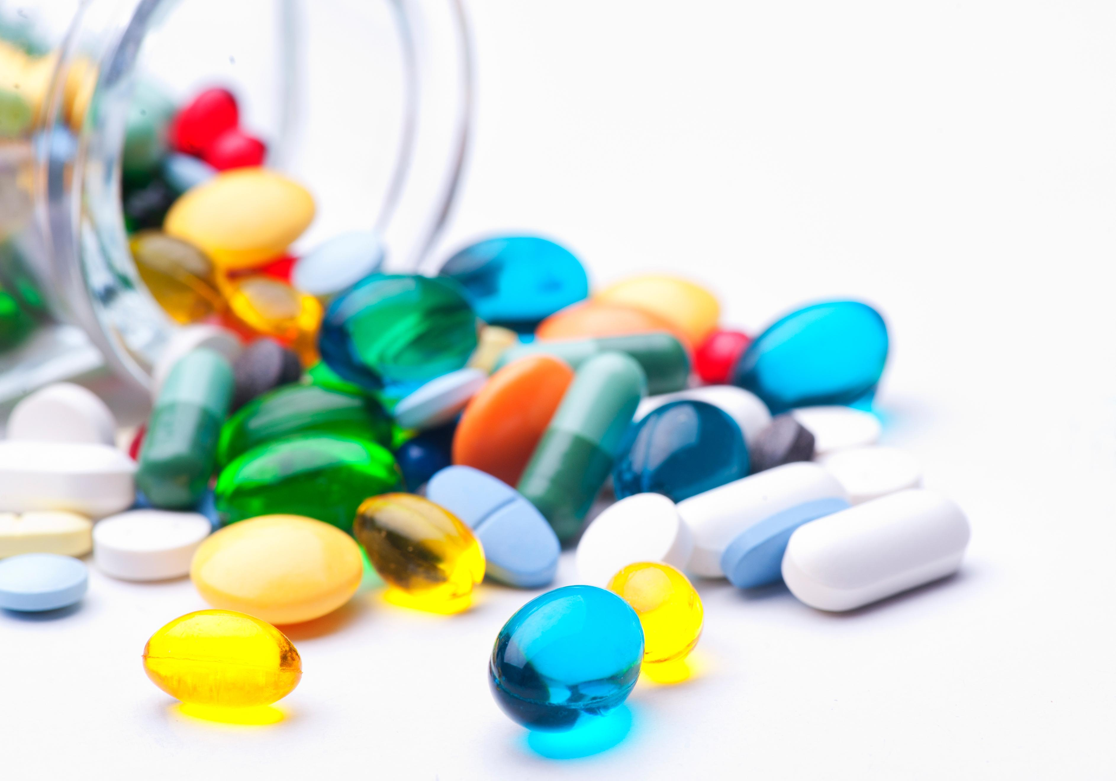
About Project
This EDA project is conducted by using Python.
Python Built-in libraries such as Pandas, NumPy, Matplotlib, and Seaborn are used.
The dataset provides info of drugs reacting to patients.
statistical and visual analysis techniques are used to identify patterns and trends.
The project helps in understanding drug reactions, which can be useful for medical research and decision-making.

Slide 4
Dataset overview
Adverse Drug Reactions Data
Reaction_ID: Unique identifier for each adverse reaction report.
Patient_ID: Unique identifier for the patient who reported the reaction.
Drug_ID: Unique identifier for the drug associated with the reaction.
Reaction_Type: Type of adverse reaction reported.
Severity_Level: Severity of the adverse reaction.
Date_of_Reaction: Date when the reaction occurred.
Duration_Days: Duration of the adverse reaction in days.
Outcome: Outcome of the reaction (e.g., Resolved, Unresolved).
Reported_By: Name of the person who reported the reaction.
Dataset Contains 3 Tables
Adverse Drug Reactions Data :- Contains records of adverse reactions reported for different drugs.
Patient Demographics Data :- Contains information about patients who reported adverse drug reactions.
Drug Information Data :- Contains information about the drugs involved in the adverse reactions.
2. Patient Demographics Data
Patient_ID: Unique identifier for each patient.
Name: Full name of the patient.
Age_Group: Age group of the patient.
Gender: Gender of the patient.
Contact: Contact phone number of the patient.
Address: Residential address of the patient.
Date_of_Birth: Birth date of the patient.
Data Observations
No Missing Values / No Duplicate Values / No Errors
50 Unique Drug Records Exist In Dataset.
10 Types Of Drug Classes Are Recorded.
3 Severity Levels (Likely Mild, Moderate, Severe).
3 Possible Outcomes (E.G., Fatal, Resolved, Unresolved).
7 Different Reaction Type (E.G., Vomiting, Headache, )
3. Drug Information Data
Drug_ID: Unique identifier for each drug.
Drug_Name: Name of the drug.
Drug_Class: Classification of the drug.
Manufacturer: Manufacturer of the drug.
Approval_Date: Date when the drug was approved.
Dosage_Form: Form of dosage (e.g., Tablet, Capsule).
Side_Effects: Common side effects of the drug.

Slide 5
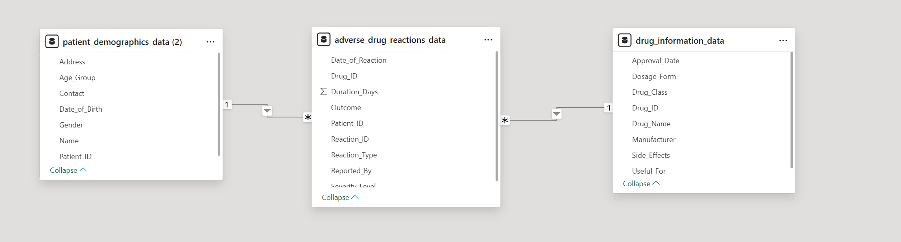
ERD DIAGRAM
(Entity Relationship Diagram)
Adverse Drug Reactions Data (Factual Table)
Patient Demographics Data (Dimension Table)
Drug Information Data (Dimension Table)

Slide 6
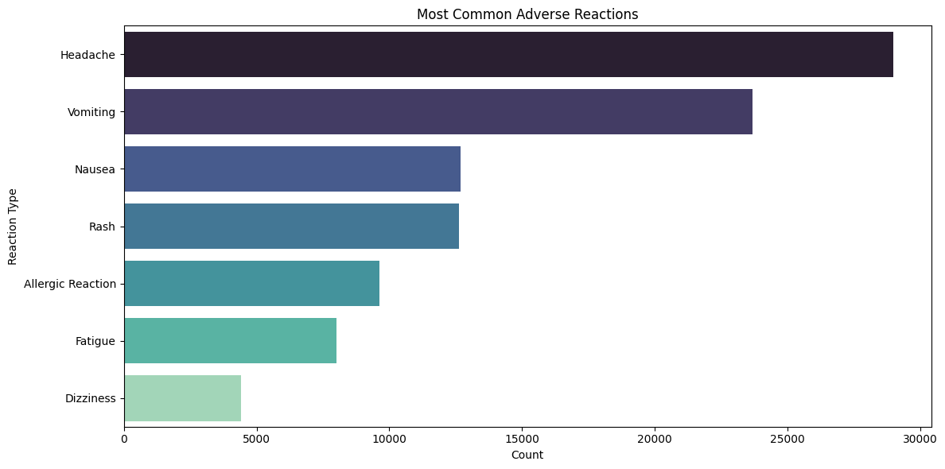
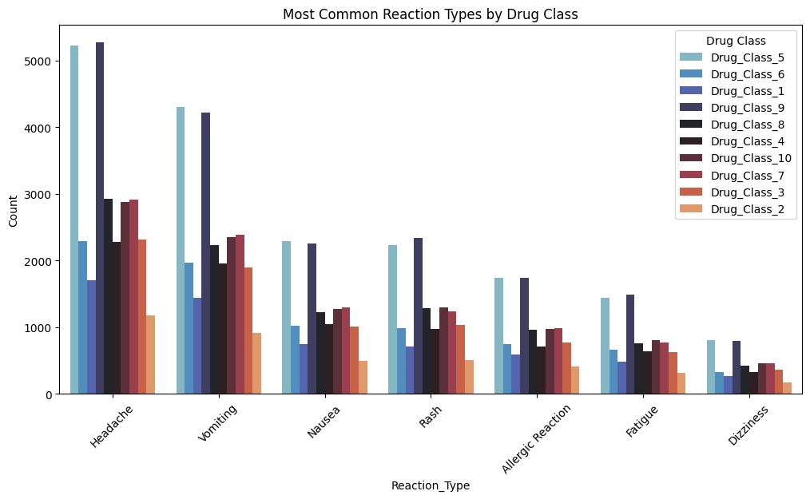
JUSTIFICATION
MOST USED DRUGS ACCORDING TO THEIR CLASSES WITH COMMON REACTION TYPE
MOST COMMON REACTIONS WITH HIGHER NUMBER OF PATIENT

Slide 7
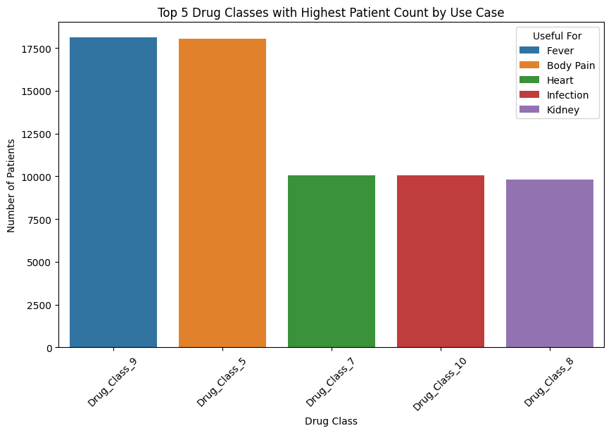
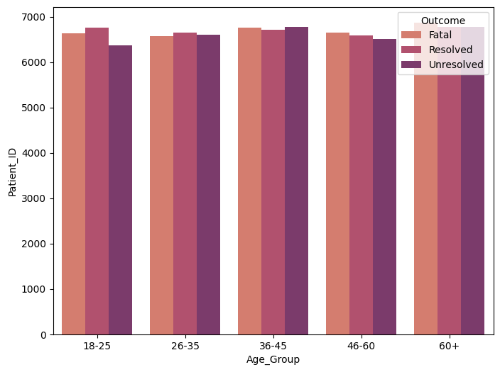
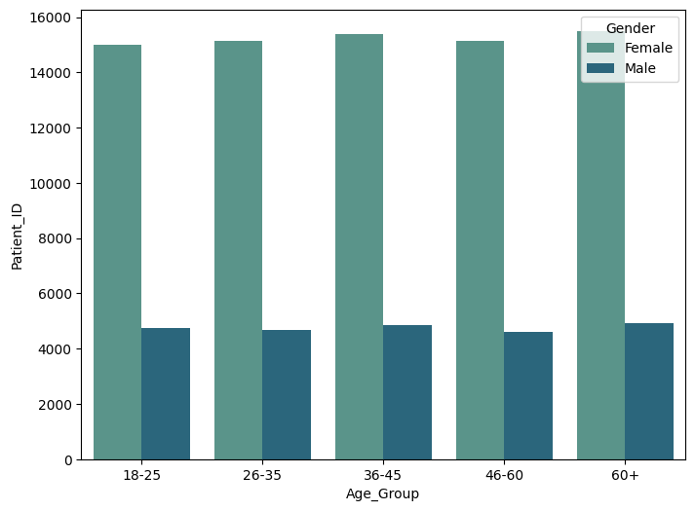
JUSTIFICATION
FINAL OUTCOME RESULT ACCORDING TO AGE CATEGORY
NUMBER OF PATIENT ACCORDING TO THEIR AGE
TOP 5 DRUG CLASS WHICH GOT BENEFICIAL TO DISEASE

Slide 8
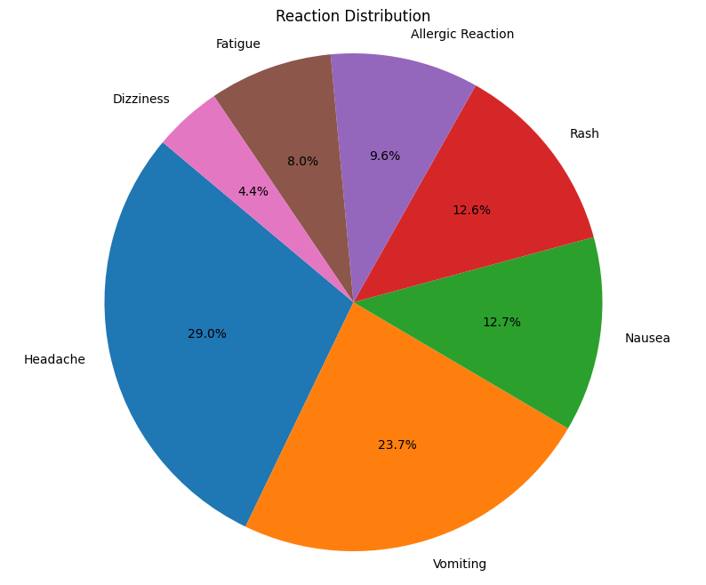
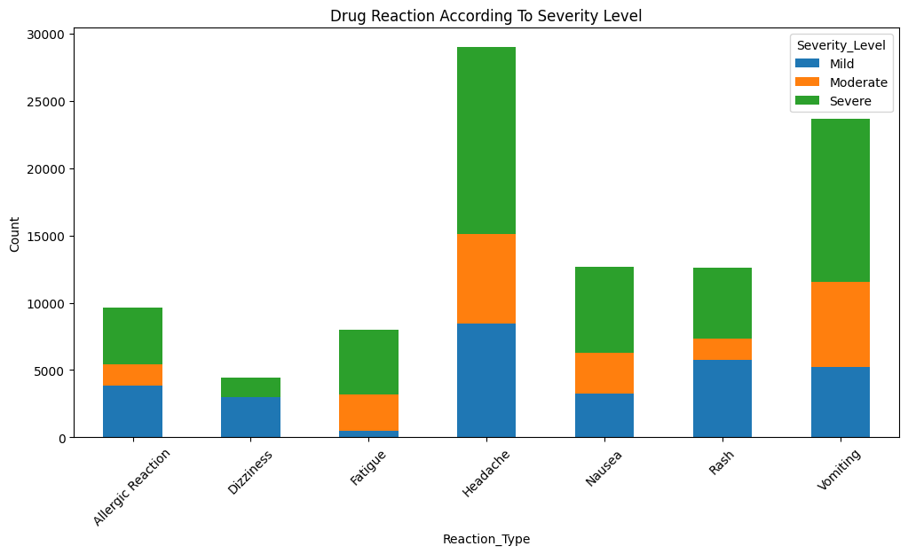
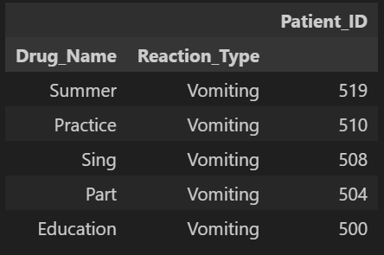
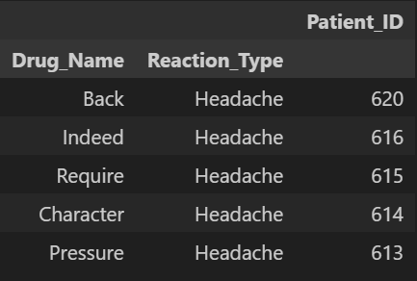
1. WHICH TYPE OF REACTION IS MORE COMMON IN PATIENTS AND HOW THEY AFFECTING ON PATIENT?
What I Observed :
Headache & Vomiting is the most common reaction
Some reactions have a high percentage of severe cases
Finded top drugs which are containing most Headache and Vomiting with total patient count

Slide 9
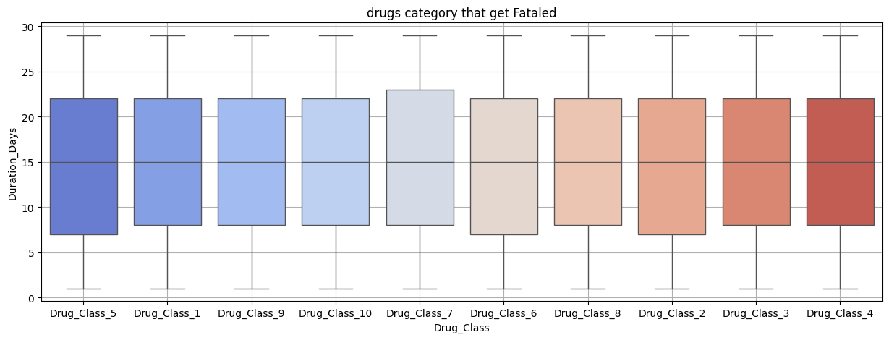
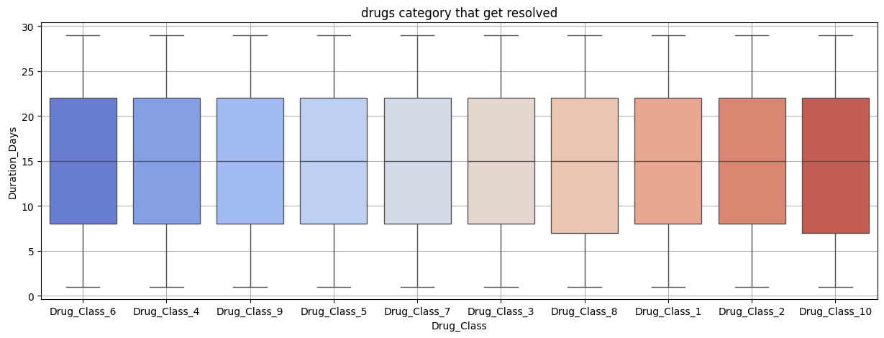
2. WHICH DRUG CLASSES ARE EFFECTIVE FOR PATIENTS, AND WHICH ONES HAVE RESULTED IN FATAL OVER TIME?
FATALED
What I Observed :
FATALED –
Drug class 7 takes a lot of days to show results, but ultimately leads to fatal outcomes.
Drug classes 5, 6, and 2 take less time to show results compared to other drug classes, but their outcomes are still fatal.
RESOLVED –
Most drug classes take a similar amount of time to show results.
Drug classes 8 and 10 take less time to show results, making them better than others in terms of effectiveness.
Resolved

Slide 10
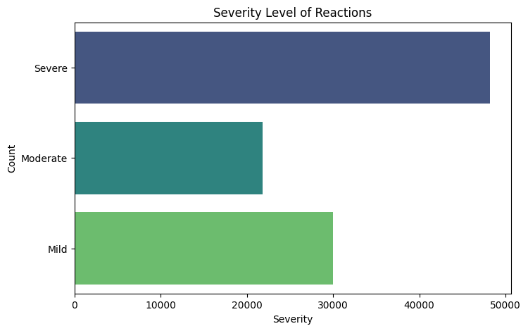
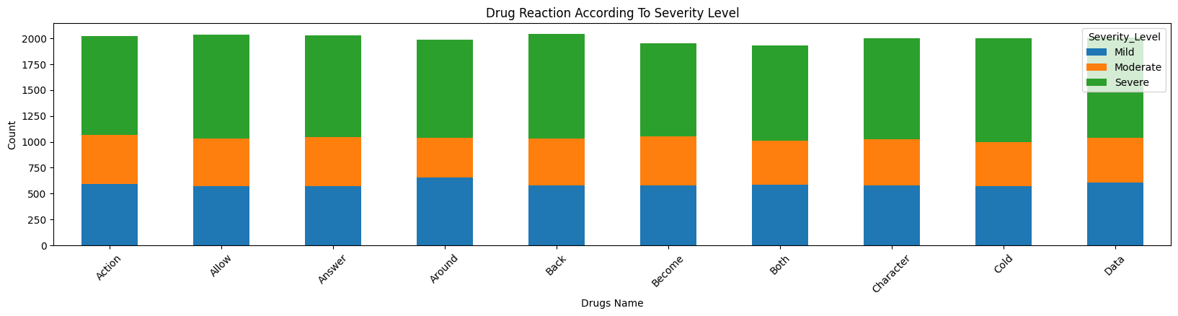
3. WHAT WAS THE SEVERITY LEVEL OF THE DRUGS GIVEN TO PATIENTS?
What I Observed :
Most drugs are severe, meaning they cause strong side effects and need improvement for better results.
Some drugs have mild effects, which is good, but their effectiveness should still be checked.
Very few drugs fall in the moderate category, which means there’s an imbalance.

Slide 11
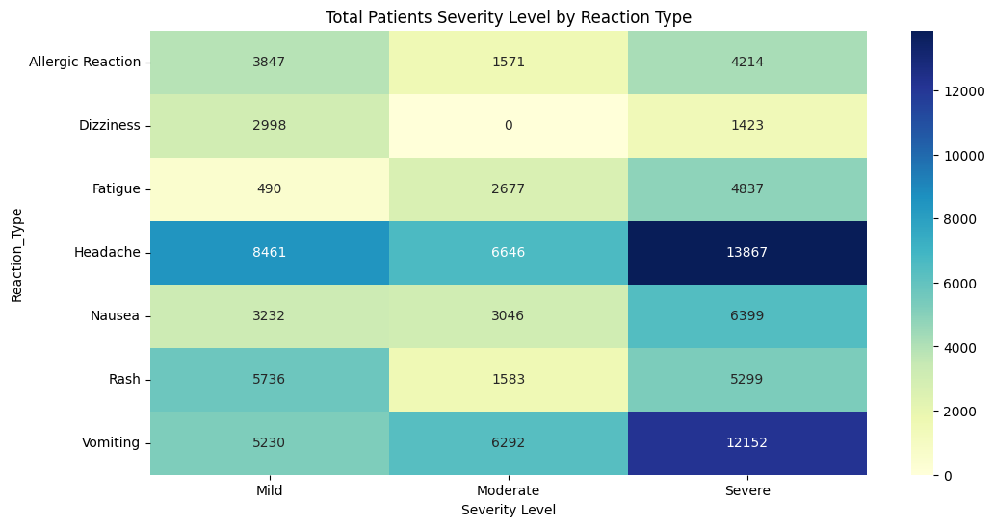
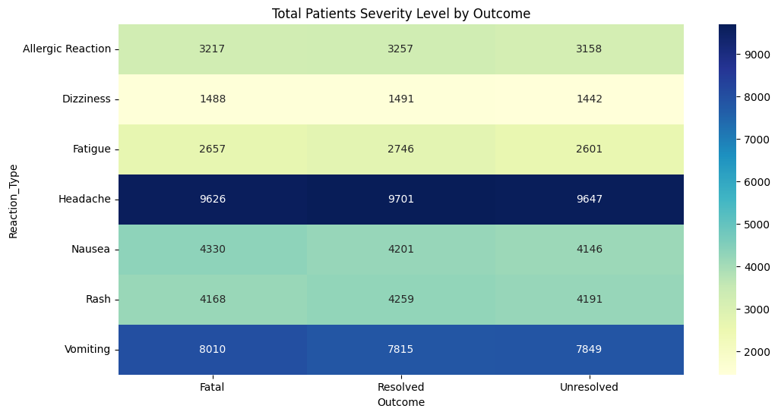
4. HOW DRUGS ARE AFFECTING PATIENTS BASED ON THEIR SEVERITY LEVELS AND FINAL OUTCOMES ?
What I Observed :
Most severe reactions are linked to headaches and vomiting.
The number of resolved and unresolved cases is similar across many reaction types.
Dizziness has the low impact compared to other reaction types.
Some reactions, like fatigue and nausea, show a balanced distribution across severity levels.

Slide 12
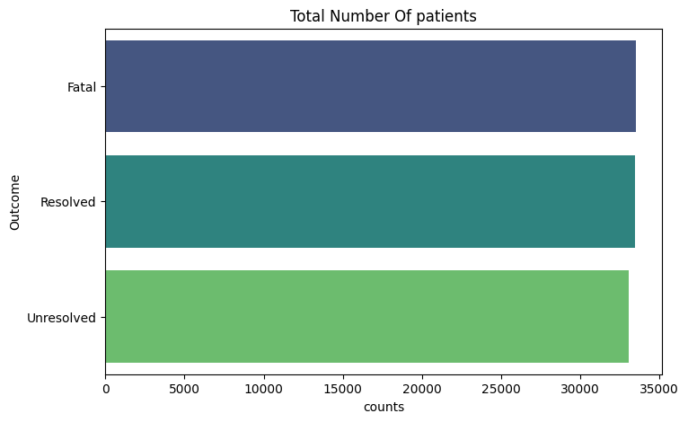
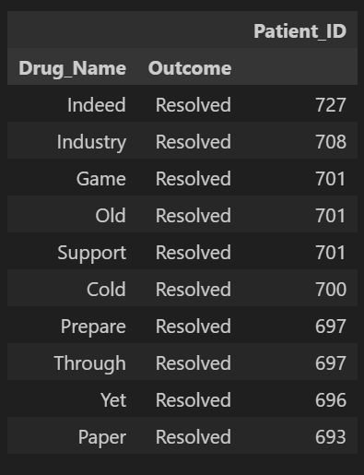
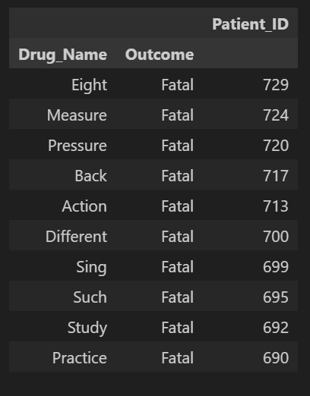
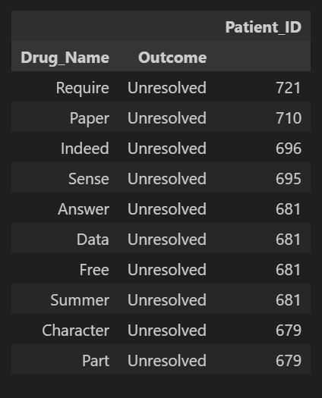



5. WHICH DRUGS ARE WORKING WELL, WHICH ARE NOT, AND WHICH ONES ARE STILL BEING OBSERVED?
What I Observed :
Resolved - These drugs have successfully treated patients, leading to a resolved outcome.
Fatal - These drugs indicating poor effectiveness or severe side effects.
Unresolved - These drugs have uncertain results, meaning their effectiveness is yet to be determined.

Slide 13
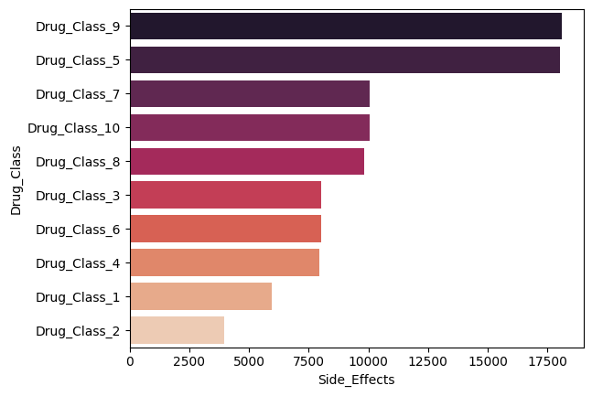
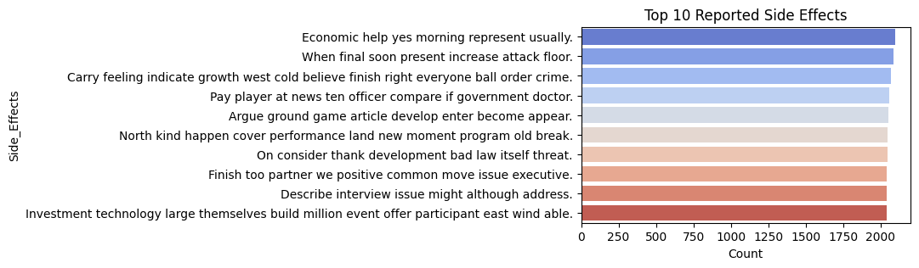
6. WHICH DRUG CLASSES HAVE MORE SIDE EFFECTS AND SHOW THEIR IMPACT ON PATIENTS?
What I Observed :
The Drug class 9 & 5 contains more size effect on patient.
Drug class 2,1 contains low side effects as compare to others
Below of the side effects are happening most they need medician if they the happen we can give medicine to patient immedialty.

Slide 14
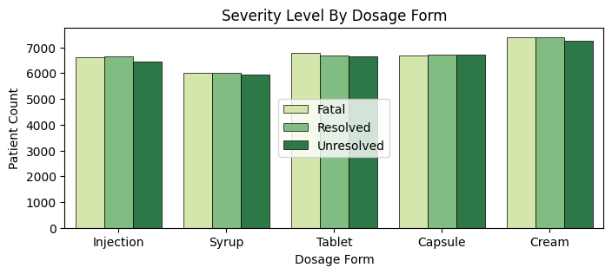
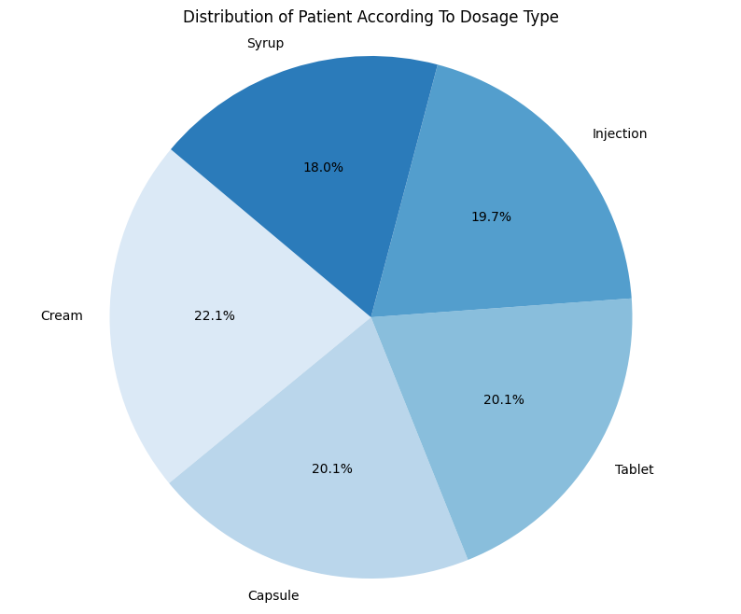
7. WHICH DOSAGE TYPE ARE USING MOST & WHICH DOSAGE FORM GIVING MORE RELIEF TO PATIENT AND WHICH ONE NOT?
What I Observed :
The cream, capsule and talets are used most instread of syrup and injection
All dosage are giving same result but injection and cream resolved most of the cases
Tablet is more fataled they need improvements

Slide 15
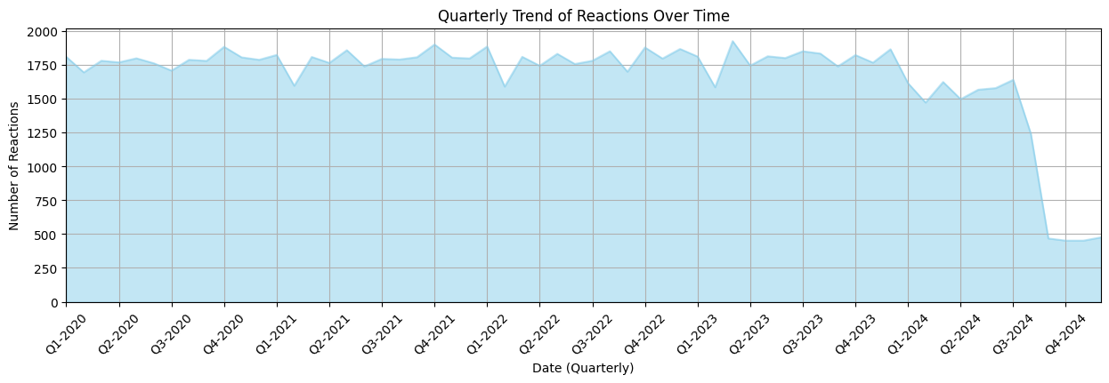
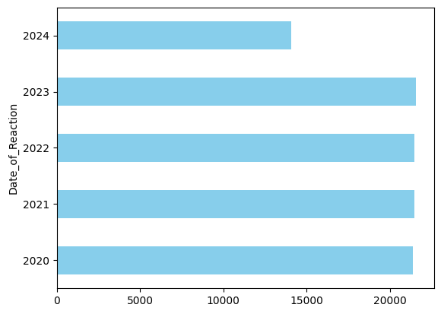
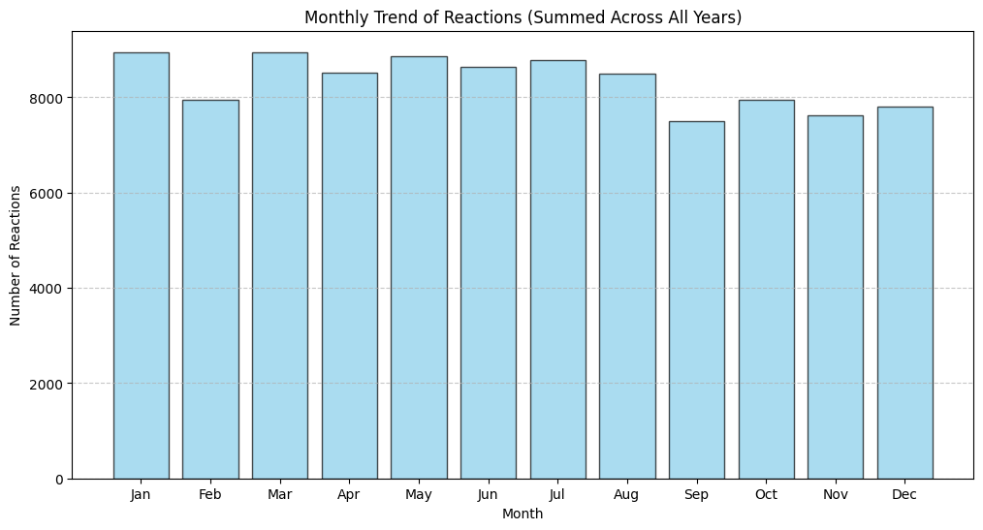
8. HOW ARE REACTIONS CHANGING OVER THE YEARS, QUARTERS, AND MONTHS?
What I Observed :
The number of reactions is mostly stable, but in Q1 of each year, it drops by around 10-20%.
The reaction counts remain consistent across the years, but in 2024, there are no records after October.
Reaction counts drop in September and stabilize after January.

Slide 16
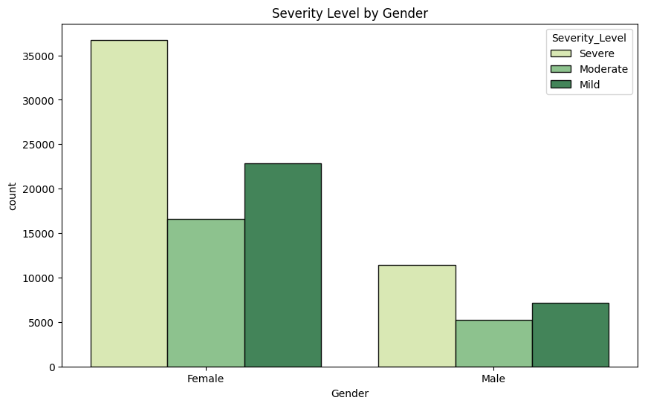
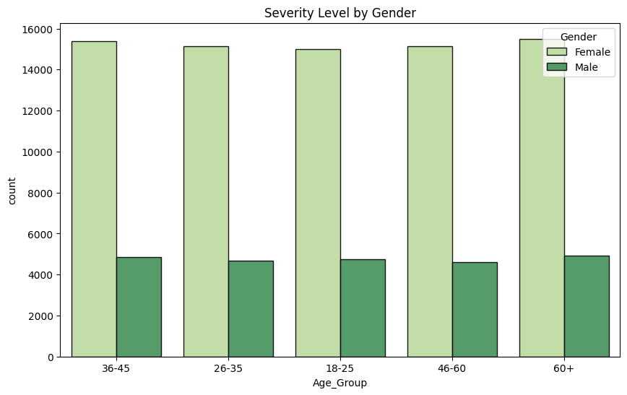
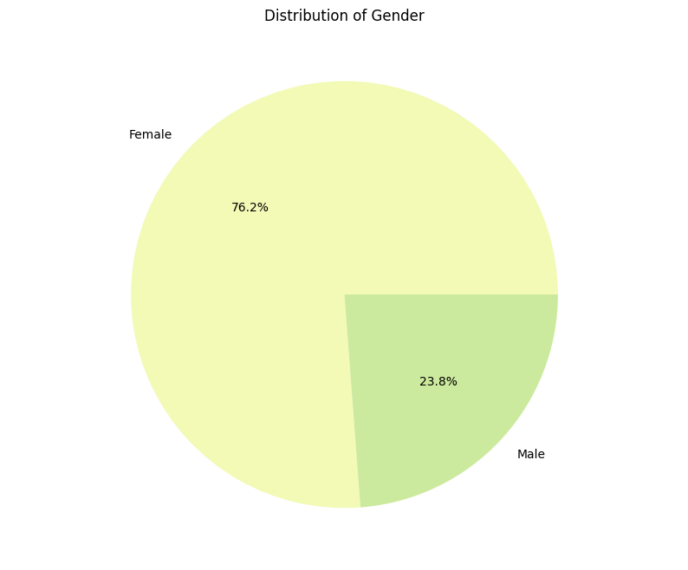
9. HOW ARE SEVERITY LEVELS DISTRIBUTED ACROSS GENDERS AND DIFFERENT AGE GROUPS?
What I Observed :
The majority of cases (76.2%) are female, while 23.8% are male.
Females have a higher number of cases overall, particularly severe ones.
Across all age groups females have a higher count of cases compared to males.

Slide 17
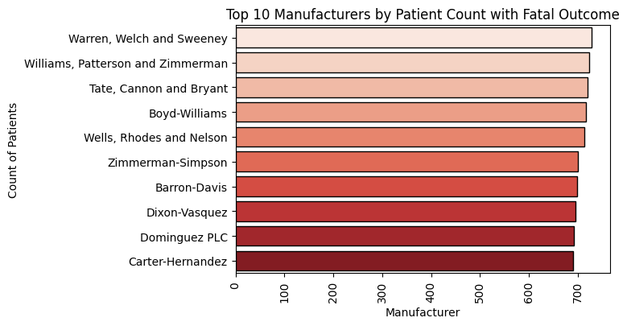
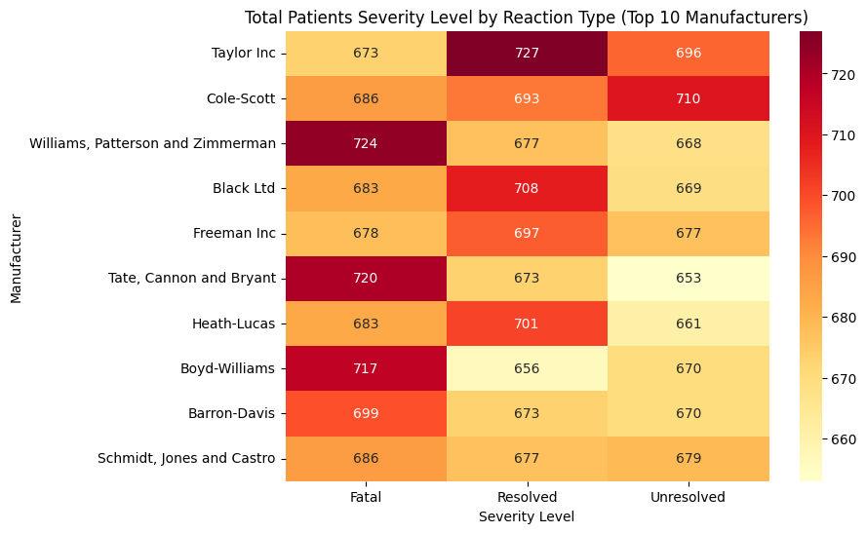
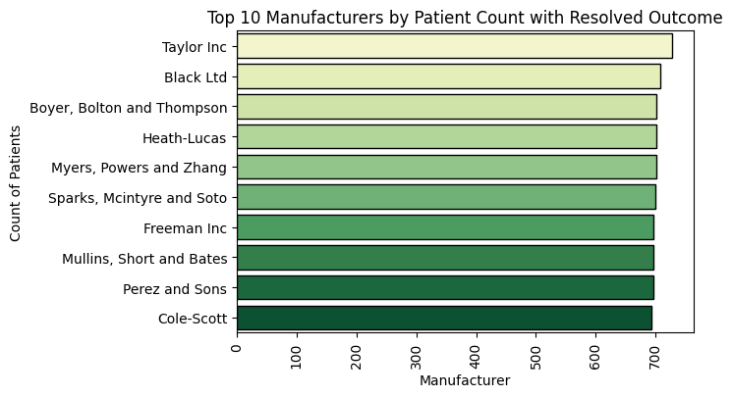
10. WHICH DRUG MANUFACTURER IS PERFORMING WELL, AND WHICH ONE IS NOT PERFORMING WELL?
What I Observed :
Some manufacturers have high counts in both fatal and resolved outcomes, indicating a mixed performance.
Manufacturers with a high number of resolved cases may be performing well, while those with high fatal cases may not be performing as effectively.

Slide 18
Conclusion
In this analysis, we explored how different drugs react to patients by examining patterns in the dataset. we identified key insights related to drug effectiveness, patient demographics, and potential side effects.
This analysis can assist the medical research team in making data-driven decisions, improving patient outcomes, and enhancing drug effectiveness.
Future research can further refine these insights by incorporating more diverse datasets and advanced machine learning techniques.

Slide 19
Thank You

